Slide 1
Collaborative Filtering and
Evaluation of Recommender Systems
Slides adopted from Francesco Ricci

Slide 2
Content
Example of Collaborative Filtering system: movielens
The collaborative filtering method
  Similarity of users
  Methods for building the prediction

Slide 3
The Collaborative Filtering Idea
Trying to predict the opinion the user will have on the different items
Be able to recommend the “best” items to each user based on: the user’s previous likings and the opinions of other like minded users
From an historical point of view CF came after content-based (we’ll see this later) but it is the most famous method
CF is a typical Internet application – it must be supported by a networking infrastructure
There is no stand alone CF application.

Slide 4






Collaborative Filtering
Negative rating
Positive rating
?

Slide 5
The CF Ingredients
List of m Users and a list of n Items
Each user has a list of items he/she expressed their opinion about (can be a null set)
  Explicit opinion - a rating score (numerical scale)
  Sometime the rating is implicitly – purchase records
Active user for whom the CF prediction task is performed
A metric for measuring similarity between users
A method for selecting a subset of neighbors for prediction
A method for predicting a rating for items not currently rated by the active user.
Negative rating
Positive rating
?

Slide 6
Collaborative-Based Filtering
The collaborative based filtering recommendation techniques proceeds in these steps:
  For a target/active user (the user to whom a recommendation has to be produced) the set of his ratings is identified
  The users more similar to the target/active user (according to a similarity function) are identified (neighbor formation)
  The products bought by these similar users are identified
  For each one of these products a prediction - of the rating that would be given by the target user to the product - is generated
  Based on this predicted rating a set of top N products are recommended.

Slide 7
A Simplified Model of Recommendation
Two types of entities: Users and Items
A background knowledge:
  A set of ratings:
    a map R: Users x Items → [0,1] U {?}
  A set of “features” of the Users and/or Items
A method for eliminating all or part of the ‘?’ values for some (user, item) pairs – substituting ‘?’ with the true values
A method for selecting the items to recommend
  Recommend to u the item i*=arg max_{i∈Items} {R(u,i)}
3. R(u, i) = Average {R(su, i)} _{su similar to u}
[Adomavicius et al., 2005]

Slide 8
Nearest Neighbor Collaborative-Based Filtering
Current User
Users
1
1st item rate
0
Dislike
?
1
1
Like
0
1
1
Items
?
Unknown
0
1
1
User Model = interaction history
0
1
1
1
1
0
14th item rate
Hamming distance
5
6
6
5
4
8
Nearest Neighbor
Notes:
Hamming distance between two strings of equal length is the number of positions for which the corresponding symbols are different.

Slide 9
1-Nearest Neighbor can be easily wrong
Current User
Users
1
1st item rate
0
Dislike
?
1
1
Like
0
1
1
Items
?
Unknown
This is the only user having a positive rating on this product
0
1
1
User Model = interaction history
0
1
1
1
1
0
14th item rate
Hamming distance
5
6
6
5
4
8
Nearest Neighbor

Slide 10
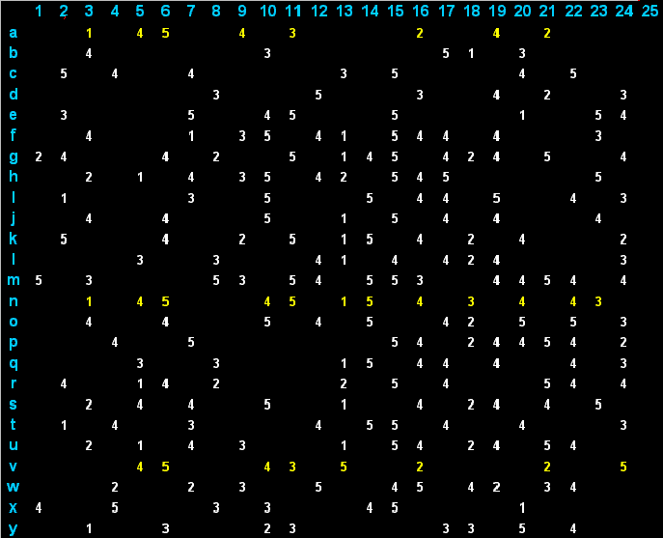
Matrix of ratings
Items
Users
Notes:
This matrix is typically very sparse

Slide 11
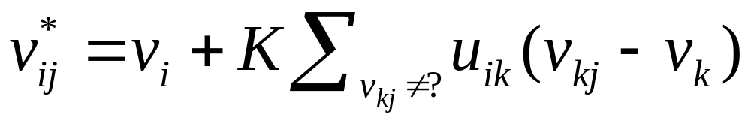
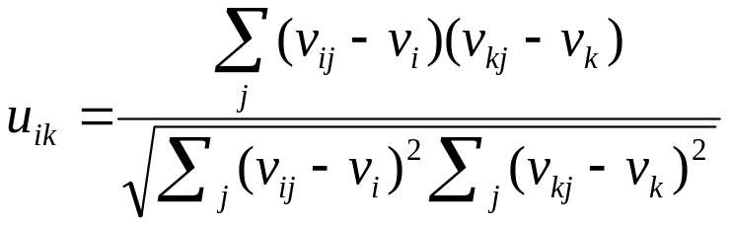
Collaborative-Based Filtering
A collection of n users u_{i} and a collection of m products p_{j}
A n × m matrix of ratings v_{ij} , with v_{ij} = ? if user i did not rate product j
Prediction for user i and product j is computed as
Where, v_{i} is the average rating of user i, K is a normalization factor such that the sum of u_{ik} is 1, and
Pearson correlation
Similarity of users i and k
Where the sum (and averages) is over j where v_{ij} and v_{kj} are not “?”.
[Breese et al., 1998]
Notes:
Fare un disegno alla lavagna in cui si mostra la matrice dei rating, la posizione dell’utente target, di 3 simili e di come viene calcolata la predizione.

Slide 12
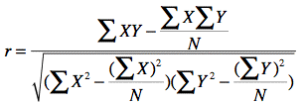
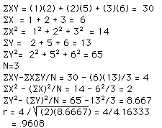
Pearson’s correlation - variation
Pearson correlation:
Numerical Example:
X = 1 2 3, Y = 2 5 6

Slide 13
Example
p_{j}
u₅
4
v₅= 4
u_{i}
?
v_{i} = 3.2
u₈
3
v₈ = 3.5
u₉
5
v₉ = 3
Users’ similarities: u_{i5} = 0.5, u_{i8} = 0.5, u_{i9} = 0.8
v*_{ij} = 3.2 + 1/(0.5+0.5+0.8) * [0.5 (4 -4) + 0.5 (3 – 3.5) + 0.8 (5 -3)
= 3.2 + 1/1.8 * [0 - 0.25 + 1.6] = 3.2 + 0.75 = 3.95

Slide 14
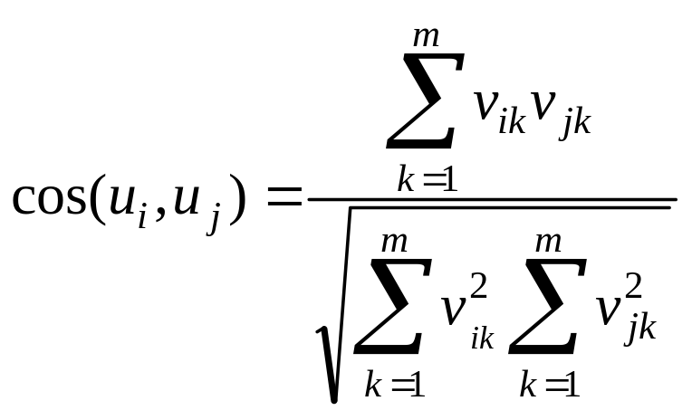
Proximity Measure: Cosine
Correlation can be replaced with a typical Information Retrieval (IR) similarity measure: cosine

Slide 15
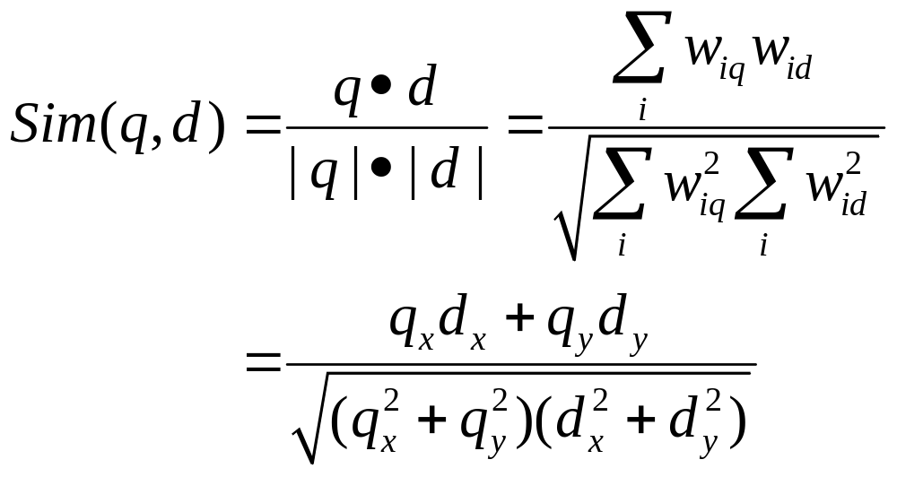
Vector-space Model in Information Retrieval
Represent the query as vector in the same document vector-space
Relevance is measured by similarity
Measure the cosine of the angle between the document-vector and the query-vector
y
d₁
d₂
for N=2
α₁
α₂
q
x

Slide 16
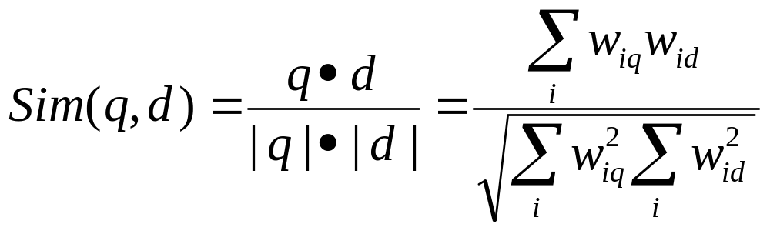
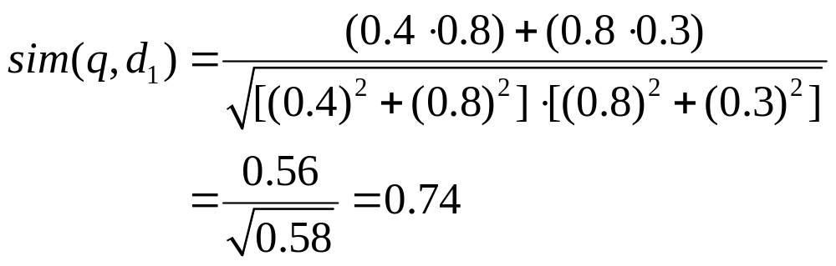

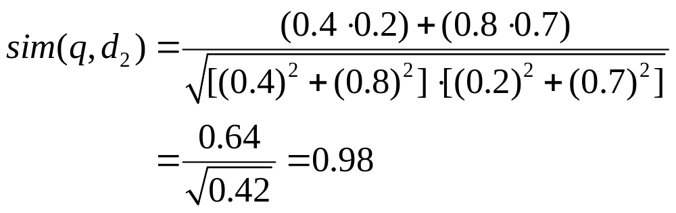

Example with documents
Term B
Q = (0.4,0.8)
D1=(0.8,0.3)
D2=(0.2,0.7)
Q
D₂
D₁
Term A

Slide 17
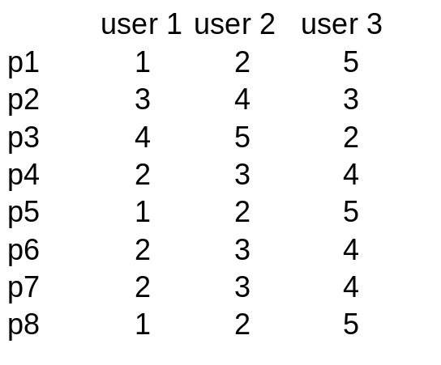
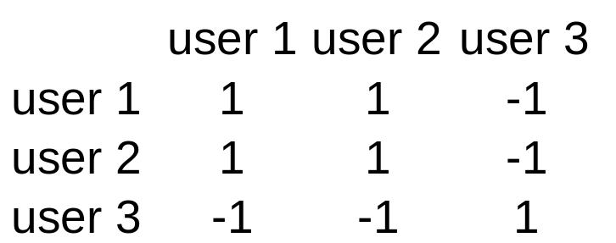
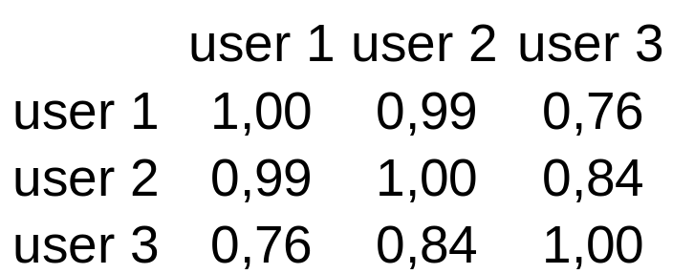
Comparison: Pearson vs. Cosine
See pearson.xls
Pearson
Cosine: user3 is closer to user2 than to user1
Cosine
User 2 ratings are those of user 1 incremented by 1
User 3 is the “opposite” of user 1
Notes:
With cosine user3 is closer to user2 than to user1
Pearson correlation - http://davidmlane.com/hyperstat/A56626.html

Slide 18
Example (cont.)
5
4
3
2
1
User 3
User 1
product 2
User 2
User 4
1 2 3 4 5
product 1
Red and green vectors (users) have Pearson correlation = -1 (ratings inverted with respect to the “average” rating 2.5)
Red vectors have a “cosine” distance smaller than green (dashed) vectors

Slide 19

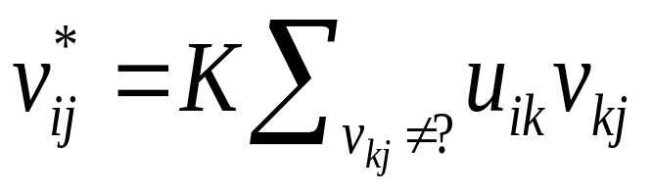
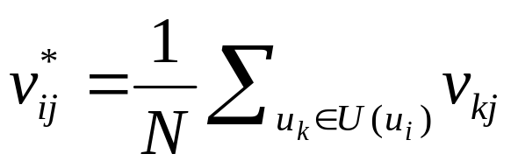
Other Aggregation Function
u_{ik} is the similarity of user u_{i}, and u_{k}
A n × m matrix of ratings v_{ij} , with v_{ij} = ? if user i did not rate product j
Prediction for user i and product j, is computed as (K is a normalization factor):
U(u_{i}) is a neighbor of users similar to u_{i} - of size N
V_{ij} = the most frequent rating in the ratings of the neighbors
Notes:
Another approach is simply to assign as prediction the most frequent rating in the ratings of the neighbors

Slide 20
Evaluating Recommender Systems
The majority focused on system’s accuracy in supporting the “find good items” user’s task
Assumption: if a user could examine all the available items, she could place them in a ordering of preference
  Measure how good is the system in predicting the exact rating value (value comparison)
  Measure how well the system can predict whether the item is relevant or not (relevant vs. not relevant)
  Measure how close the predicted ranking of items is to the user’s true ranking (ordering comparison).

Slide 21
How Has Been Measured
Split the available data (so you need to collect data first!), i.e., the user-item ratings into two sets: training and test
Build a model on the training data
  For instance, in a nearest neighbor (memory-based) CF simply put the ratings in the training in a separate set
Compare the predicted rating on each test item (user-item combination) with the actual rating stored in the test set
You need a metric to compare the predicted and true rating

Slide 22
Splitting the data
Does not work
items
users
train
test

Slide 23
Splitting the data
Does not work
items
users
train
test

Slide 24
Splitting the data
It works !
items
users
train
test

